Slide 1

UNIVERSITY OF MAKENI
SYLVANUS KOROMA CAMPUS
YONI
Project Report on [CELEBRITY QUIZ]
Prepared By:
Malcom Kpundeh 4392
Edward s. Sesay 4421
­­Fatmata Nabsatu Koroma 4403
Submitted to: Mr. MUSA
Date: 13th April, 2021

Slide 2
ABSTRACT
The Celebrity Quiz is a project that written in an Android studio, the objective of this Android Application is to implement a way for people to known their famous Celebrity.

Slide 3
Table of content
Introduction
Background
Implementation
Result
Conclusion
Reference

Slide 4
Introduction
CelebrityQuizApp is an android based application, and enables the user to undertake a series of questions on Java language. The app is user friendly, and the user shall find it extremely easy to answer the multiple-choice questions. At the end of the quiz, a result-report is generated which states the score. The app also presents an option to the current user to play again or quit in between.

Slide 5
Implementation
Celebrity quiz app is an android based application that is developed using android studio. The app is user friendly and very easy to use and it is made up of stages. Stage one: Stage one is going to be played for 30 seconds, if the question is not answered within the time frame the game will stop and ask the player to play again on till the quiz is answered correctly. Activities in the stage one: Image– displays the image of the celebrity. Questions – displays question to be answered. Results – displays Results after finishing the quiz Stage two Stage two is going to be played for 60 seconds, if the question is not answered within the time frame the game will stop and ask the player to play again on till the quiz is answered correctly Activities in the stage two: Image– displays the image of the celebrity. Questions – displays MCQ’s and currents Score. Results – displays Results after finishing the quiz

Slide 6
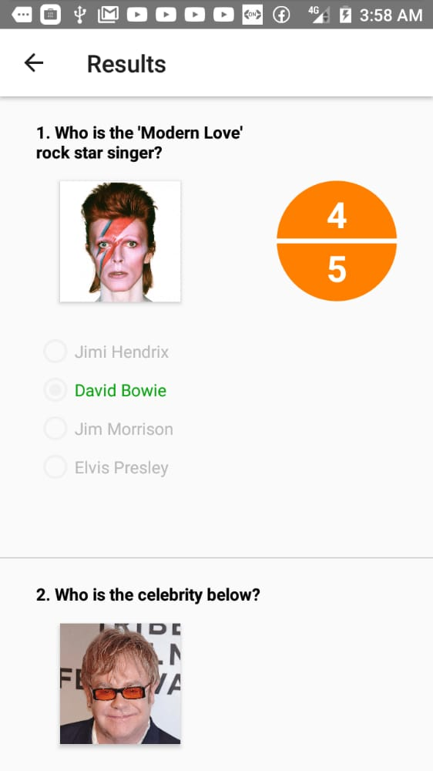
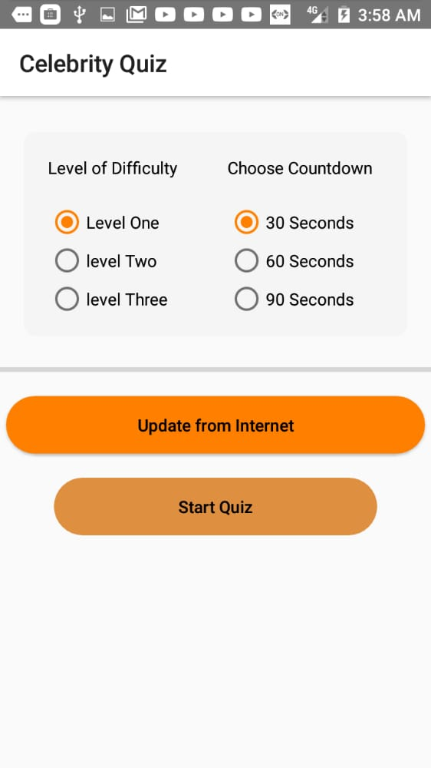
RESULT

Slide 7
Reference
1.greekforgreek.com

